Slide 1
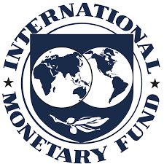
International Monetary Systems
Topic: International institutions

Slide 2
Administrative things
Course syllabus, group presentation info, slides used in class will be posted on:
http://davemcevoy.weebly.com/imsangers.html
You will indicate which financial crisis your group will present on by editing a Google Doc. The link to the document is:
goo.gl/Xjl09g

Slide 3
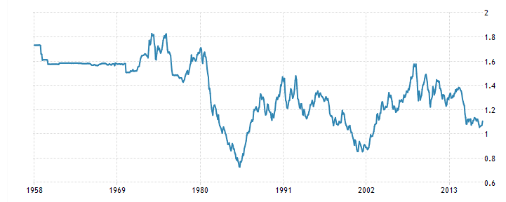
Historic US Dollar – Franc Exchange Rate
1958 - 2013
What was going on here with the US dollar – Franc Exchange Rate?

Slide 4
Broad types of exchange systems
Floating
Let the markets decide the exchange rate (supply and demand)
Fixed (or pegged)
Deliberate efforts are made to fix the exchange rate to some target or within a defined band (e.g., + and – 2%)

Slide 5
The bimetallic standards (gold and silver)
Example: France (Monetary Law of 1803) required MINT to supply gold and silver coins at ratio of 15.5 oz silver to 1 oz gold.
Maintaining bimetallic standards in a “world market” was hard.
There was a fluctuating market price for silver-gold (buyers and sellers) and there was the mint’s fixed ratio.
Late 19th century the market price of silver rose substantially. It rose to 16 oz silver to 1 oz gold.
Given the differences between the market and the mint, what happened to circulation of gold and silver in France?

Slide 6
The bimetallic standards (gold and silver)
Example: France (Monetary Law of 1803) required MINT to supply gold and silver coins at ratio of 15.5 oz silver to 1 oz gold.
Maintaining bimetallic standards in a “world market” was hard.
There was a fluctuating market price for silver-gold (buyers and sellers) and there was the mint’s fixed ratio.
Late 19th century the market price of silver rose substantially. It rose to 16 oz silver to 1 oz gold.
Given the differences between the market and the mint, what happened to circulation of gold and silver in France?

Slide 7
The bimetallic standards (gold and silver)
Arbitrage opportunities.
Convert silver to gold using the French Mint. Sell 15.5 oz of silver get 1 oz gold.
Take that 1 oz of gold and sell it for 16 oz of silver on the market.
Profit of 0.5 oz of silver.
When gold at home is undervalued (relative to the market) it means gold is going to leave (and silver comes in).

Slide 8
Gresham’s Law
Bad money (e.g., silver) drives out the good money (e.g., gold).
What would happen if the exchange for silver on the market dropped to 14 oz silver to 1 oz gold? (no change in mint’s rate)
Silver strengthened against gold.
Convert 1 oz of gold to 15.5 ounces of silver at the mint. Then sell that 15.5 oz of silver for 1.107 oz of gold.
Here silver goes out and gold comes in.

Slide 9
Gold (19th century to early 1970s)

Slide 10
The theory
David Hume (1752): The price-specie flow model
Countries either exchanged gold directly or had currencies that could be converted to gold at a posted rate. Reserves of gold were kept to maintain convertibility.
Suppose France has a trade deficit with Germany (imports > exports). At this point gold leaves France (payments) and enters Germany (deposits).
With less circulating money in France, prices fall in France (deflation). Germany sees prices inflate.

Slide 11
The theory (continued)
With less circulating money in France, prices fall in France (deflation). Germany sees prices inflate.
Germany now sees an advantage to increasing imports from France (cheaper). So the direction of transactions and flow of gold switches.
The theory is that this mechanism will keep things in balance.

Slide 12
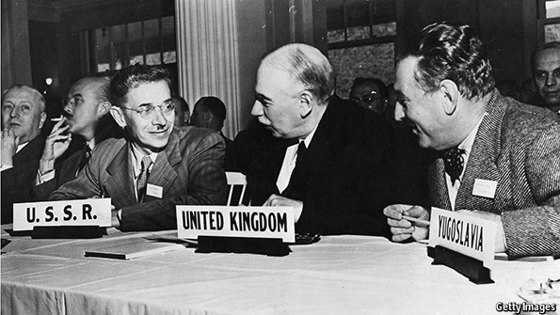
Bretton Woods – the IMF (1945) and the World Bank

Slide 13
Bretton woods system (1945 – 1972)
1944 meeting in the Mt. Washington Hotel in Bretton Woods, NH. 44 Nations.
The goal was exchange rate stability that was less restrictive than the classical gold standard
The U.S. dollar was pegged to gold at $35 per oz of gold.
Other major currencies were pegged to the US $ (and many indirectly pegged to the US dollar)
Maintain exchange rate by +- 1% of target by buying or selling foreign reserves as necessary. How does this work?

Slide 14
Bretton woods system (1945 – 1972)
Post WW2 the US had about 2/3 of the world’s gold reserves (partly explaining why they are the reserve country that others pegged to)
Tried to limit interest rate arbitrage by controlling capital markets
Expenses from the Vietnam War required US to print money, thus causing fear that the US would not have adequate gold reserves to convert dollars to gold. Other countries started to devalue to promote exports
1971 Nixon abandoned the gold standard marking the end of convertibility to gold.

Slide 15
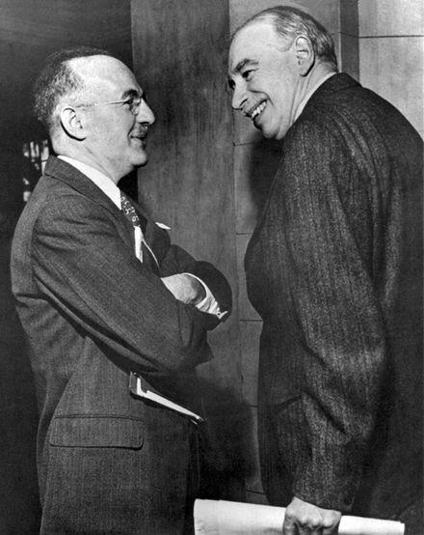
International Monetary Fund (IMF)
Crafted in Bretton Woods in 1944, entered into force in 1945 with 29 initial member countries
IMF primary purpose is to ensure the stability of the international monetary system – the system of exchange rates and international payments that enables countries to transact with another.
May 8 1947 the IMF made its first loan – to France.
Today 188 members
Harry Dexter White and John Maynard Keynes (1944)

Slide 16
International Monetary Fund (IMF)
The purposes of the International Monetary Fund are:
(i) To promote international monetary cooperation through a
permanent institution which provides the machinery for
consultation and collaboration on international monetary
problems.
(ii) To facilitate the expansion and balanced growth of international
trade, and to contribute thereby to the promotion
and maintenance of high levels of employment and real
income and to the development of the productive resources
of all members as primary objectives of economic policy.
(iii) To promote exchange stability, to maintain orderly
exchange arrangements among members, and to avoid
competitive exchange depreciation.

Slide 17
International Monetary Fund (IMF)
To sum it up:
(i) Consultation and advice
(ii) Promote trade and economic growth
(iii) Exchange stability

Slide 18
International Monetary Fund (IMF)
The purposes of the International Monetary Fund are:
(iv) To assist in the establishment of a multilateral system of
payments in respect of current transactions between members
and in the elimination of foreign exchange restrictions
which hamper the growth of world trade.
(v) To give confidence to members by making the general
resources of the Fund temporarily available to them
under adequate safeguards, thus providing them with
opportunity to correct maladjustments in their balance
of payments without resorting to measures destructive of
national or international prosperity.
(vi) In accordance with the above, to shorten the duration and
lessen the degree of disequilibrium in the international
balances of payments of members.

Slide 19
International Monetary Fund (IMF)
To sum it up:
(iv) reduce trade/exchange restrictions
(v) provide access to funds
(vi) balance trade

Slide 20
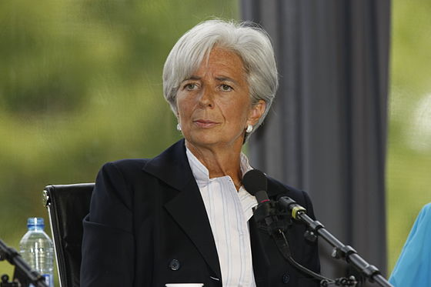
IMF – Leadership Structure
Board of Governors: one governor and one alternate from each member country.
Annual meeting
Appoints executive board members
Approve quotas, Special Drawing Right allocations, admitting new members, withdrawals and amendments to the Articles of the Agreement
BOG is advised by the International Monetary and Financial Committee and the Development Committee
Executive Board – 24 Executive Directors (1 in big countries, other share)
Managing Director (European) – current = Christine Lagarde

Slide 21
IMF – Quotas
Quotas determine the standing a member country has in the IMF
The quota is like an entry free – the amount of money a member must contribute to the fund. The quota can be paid in different currencies, but ¾ must be paid in home currency.
The quota amount is determined relative to the economic size of the country.
France = 20 billion SDR (about 4.2%)
United States = 83 billion SDR (about 17.4%) - largest
Voting Power
Fixed number of “basic” votes
1 vote for every 100,000 in quota (measured in special drawing rights) contributed to the fund

Slide 22
IMF – Quotas
Available credit: The amount of financing a member can obtain from the IMF is a function of their quota (145% of quota annually, 435% cumulative). However, these rules have been broken.
By definition, large developed countries have more access to credit than smaller developing countries.
BOG reviews quotas about every 5 years. Changes need an 85% vote of support.
As of January 2016, the total quota is 477 billion SDR ($653 billion).

Slide 23
IMF - Special Drawing Rights (SDR)
The IMF’s accounting unit is called a special drawing right (SDR) – established in 1969
The value of a unit of SDR is determined by a basket of currencies.
The makeup of the basket has changed over time. At first it was equivalent to the US dollar. Today it is a weighted sum of US, Europe, China, Japan, and British currencies.
Originally created as a supplementary reserve currency potentially useful for countries pegging their currency to the dollar (which was pegged to gold).
Members needed reserves of dollars to maintain pegs. Dollars were scarce (US large trade surplus)

Slide 24
IMF - Special Drawing Rights (SDR)
Allocations of SDRs are freely given to member countries in proportion to their quotas.
The SDRs are reserve assets, that may be exchanged for circulating currencies at a posted rate.
SDRs are bought and sold voluntarily (through the terms of the Articles of the Agreement) by IMF members.
If you are a buyer of SDR then your holdings > allocation and the IMF pays interest on the excess.
If you are seller of SDR then your holdings < allocation and you pay interest on the shortage.
The biggest allocation of SDR was in 2009 for 161 billion SDR.

Slide 25
IMF - Special Drawing Rights (SDR)
Allocations of SDRs are freely given to member countries in proportion to their quotas.
The SDRs are reserve assets, that may be exchanged for circulating currencies at a posted rate.
SDRs are bought and sold voluntarily (through the terms of the Articles of the Agreement) by IMF members.
If you are a buyer of SDR then your holdings > allocation and the IMF pays interest on the excess.
If you are seller of SDR then your holdings < allocation and you pay interest on the shortage.
The biggest allocation of SDR was in 2009 for 161 billion SDR.

Slide 26
IMF - Special Drawing Rights (SDR)
Currency | Amount | $ to buy 1 foreign | Amount in US$ | Weights
US Dollar | 0.5825 | 1 | 0.5825 | 42%
Euro | 0.3867 | 1.12 | 0.4331 | 31%
Renminbi | 1.0174 | 0.15 | 0.1526 | 11%
Yen | 11.9 | 0.0091 | 0.1083 | 8%
Pound | 0.0859 | 1.28 | 0.1100 | 8%
 |  | Dollars needed to buy one SDR | 1.39

Slide 27
IMF – some criticisms

Slide 28
The World Bank
Two overarching goals:
End extreme poverty
Promote shared prosperity

Slide 29
The World Bank
International Bank for Reconstruction and Development (IBRD)
Created in 1944 to help Europe rebuild after World War II; original World Bank institution
Over $500 billion in loans to alleviate poverty around the world since 1946
Triple-A rated since 1959. High credit rating allows it to borrow at low cost and offer middle-income developing countries access to capital on favorable terms -- in larger volumes, with longer maturities, and in a more sustainable manner than world financial markets typically provide.

Slide 30
The World Bank
International Development Association (IDA)
Established in 1960
Extends loans at low interest rates to poor nations that cannot qualify for loans from other institutions
Makes loans and grants to programs that boost economic growth, reduce inequalities, and improve people’s living conditions.
Is funded largely by contributions from the governments of its richer member countries.

Slide 31
The World Bank
International Financial Corporation (IFC)
Promotes private enterprise within countries
Provides loans to corporations and purchases stock
It traditionally has obtained financing from the World Bank but can borrow in the international financial markets.

