Slide 1
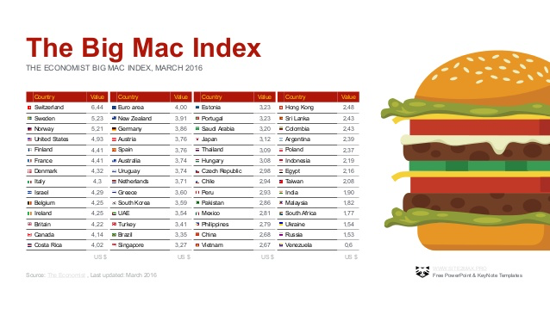
International Monetary Systems
Topic: Exchange, PPP and International Monetary Systems

Slide 2
Administrative things
Course syllabus, group presentation info, slides used in class will be posted on:
http://davemcevoy.weebly.com/imsangers.html
You will indicate which financial crisis your group will present on by editing a Google Doc. The link to the document is:
goo.gl/Xjl09g

Slide 3
Group Work: Arbitrage (with three countries)
E£/€ = 0.70 and E€/$ = 0.80
(1) What is the “indirect” exchange rate of pounds to dollars?
Now compare pound-dollar spot rates with this calculated “indirect” exchange rate to see if arbitrage possibilities exist.
Suppose, for example, the spot rate is E£/$ = 0.50.
(2) You have $1,000 to start. How can you make a profit in $?

Slide 4
Group Work: Arbitrage (with three countries)
E£/€ = 0.70 and E€/$ = 0.80
(1) What is the “indirect” exchange rate of pounds to dollars?
E£/€ * E€/$ = E£/$ = 0.56
Now compare pound-dollar spot rates with this calculated “indirect” exchange rate to see if arbitrage possibilities exist.
Suppose, for example, the spot rate is E£/$ = 0.50.
(2) You have $1,000 to start. How can you make a profit?
Take $1000 and buy 560 pounds indirectly by first buying euros (800) and then converting to pounds.
Then sell 560 pounds at the spot rate of 2 dollars for 1 pound. $1120. Profit of $1.12 on the dollar.

Slide 5
Forward exchange rate: the role of interest
Value of european investment in dollars one year from now
$(1+i$) = $ E€/$ (1+i€) F$/€
Value of dollar investment in US bank in one year
Exchange rate in the future -- converting euros back to dollars
Euros in exchange for dollars today (spot rate)
Value of investment in euros one year from now

Slide 6
Forward exchange rate: the role of interest
$(1+i$) = $ E€/$ (1+i€) F$/€
$(1+i$) / $ E€/$ (1+i€) = F$/€
F$/€ = E$/€ (1+i$) /(1+i€)
Theory of where the Forward exchange rate come from

Slide 7
Forward exchange rate: the role of interest
F$/€ = E$/€ (1+i$) /(1+i€)
Suppose the spot rate is E$/€ = 1.10:
If the interest rate for both the U.S. and European investments are equal then what is the Forward exchange rate?
If the interest rate for the U.S. investment is 0.05 and the European interest rate is 0.035, what is the Forward exchange rate?

Slide 8
Group Work: Forward exchange rate: the role of interest
F$/€ = E$/€ (1+i$) /(1+i€)
Suppose the spot rate is E$/€ = 1.10:
If the interest rate for both the U.S. and European investments are equal then what is the Forward exchange rate?
If the interest rate for the U.S. investment is 0.05 and the European interest rate is 0.035, what is the Forward exchange rate?

Slide 9
Law of one price
LO1P: Identical goods sold in two different locations must sell for the same price when expressed in common currency.
P($)
P($)
$20
$18
Q
Q
PARIS
U.S.

Slide 10
Purchasing Power (a basket of goods)
The relative prices of baskets of goods compared in the same currency
P€ E$/€ /P$ = real exchange rate
It is the price of European basket relative to the US basket.
if P€ E$/€ /P$ is increasing then prices are higher in Europe and the US currency is depreciating – the dollar can buy fewer baskets in euros

Slide 11
Purchasing power parity (PPP)
Identical baskets of goods sold in two different locations must sell for the same price when expressed in common currency.
$
$
$20
$18
£
£
FRANCE
U.S.
P€E$/€ =P$

Slide 12
Spot exchange rate implied by PPP
Rearranging the real exchange rate formula given that PPP holds:
E$/€ =P$/P€
Implication: The spot exchange rate should follow the relative prices of a representative basket of goods

Slide 13
US vs. United Kingdom
Blue line –
E£/$
Red line –
P£/P$

Slide 14
US vs. France

Slide 15
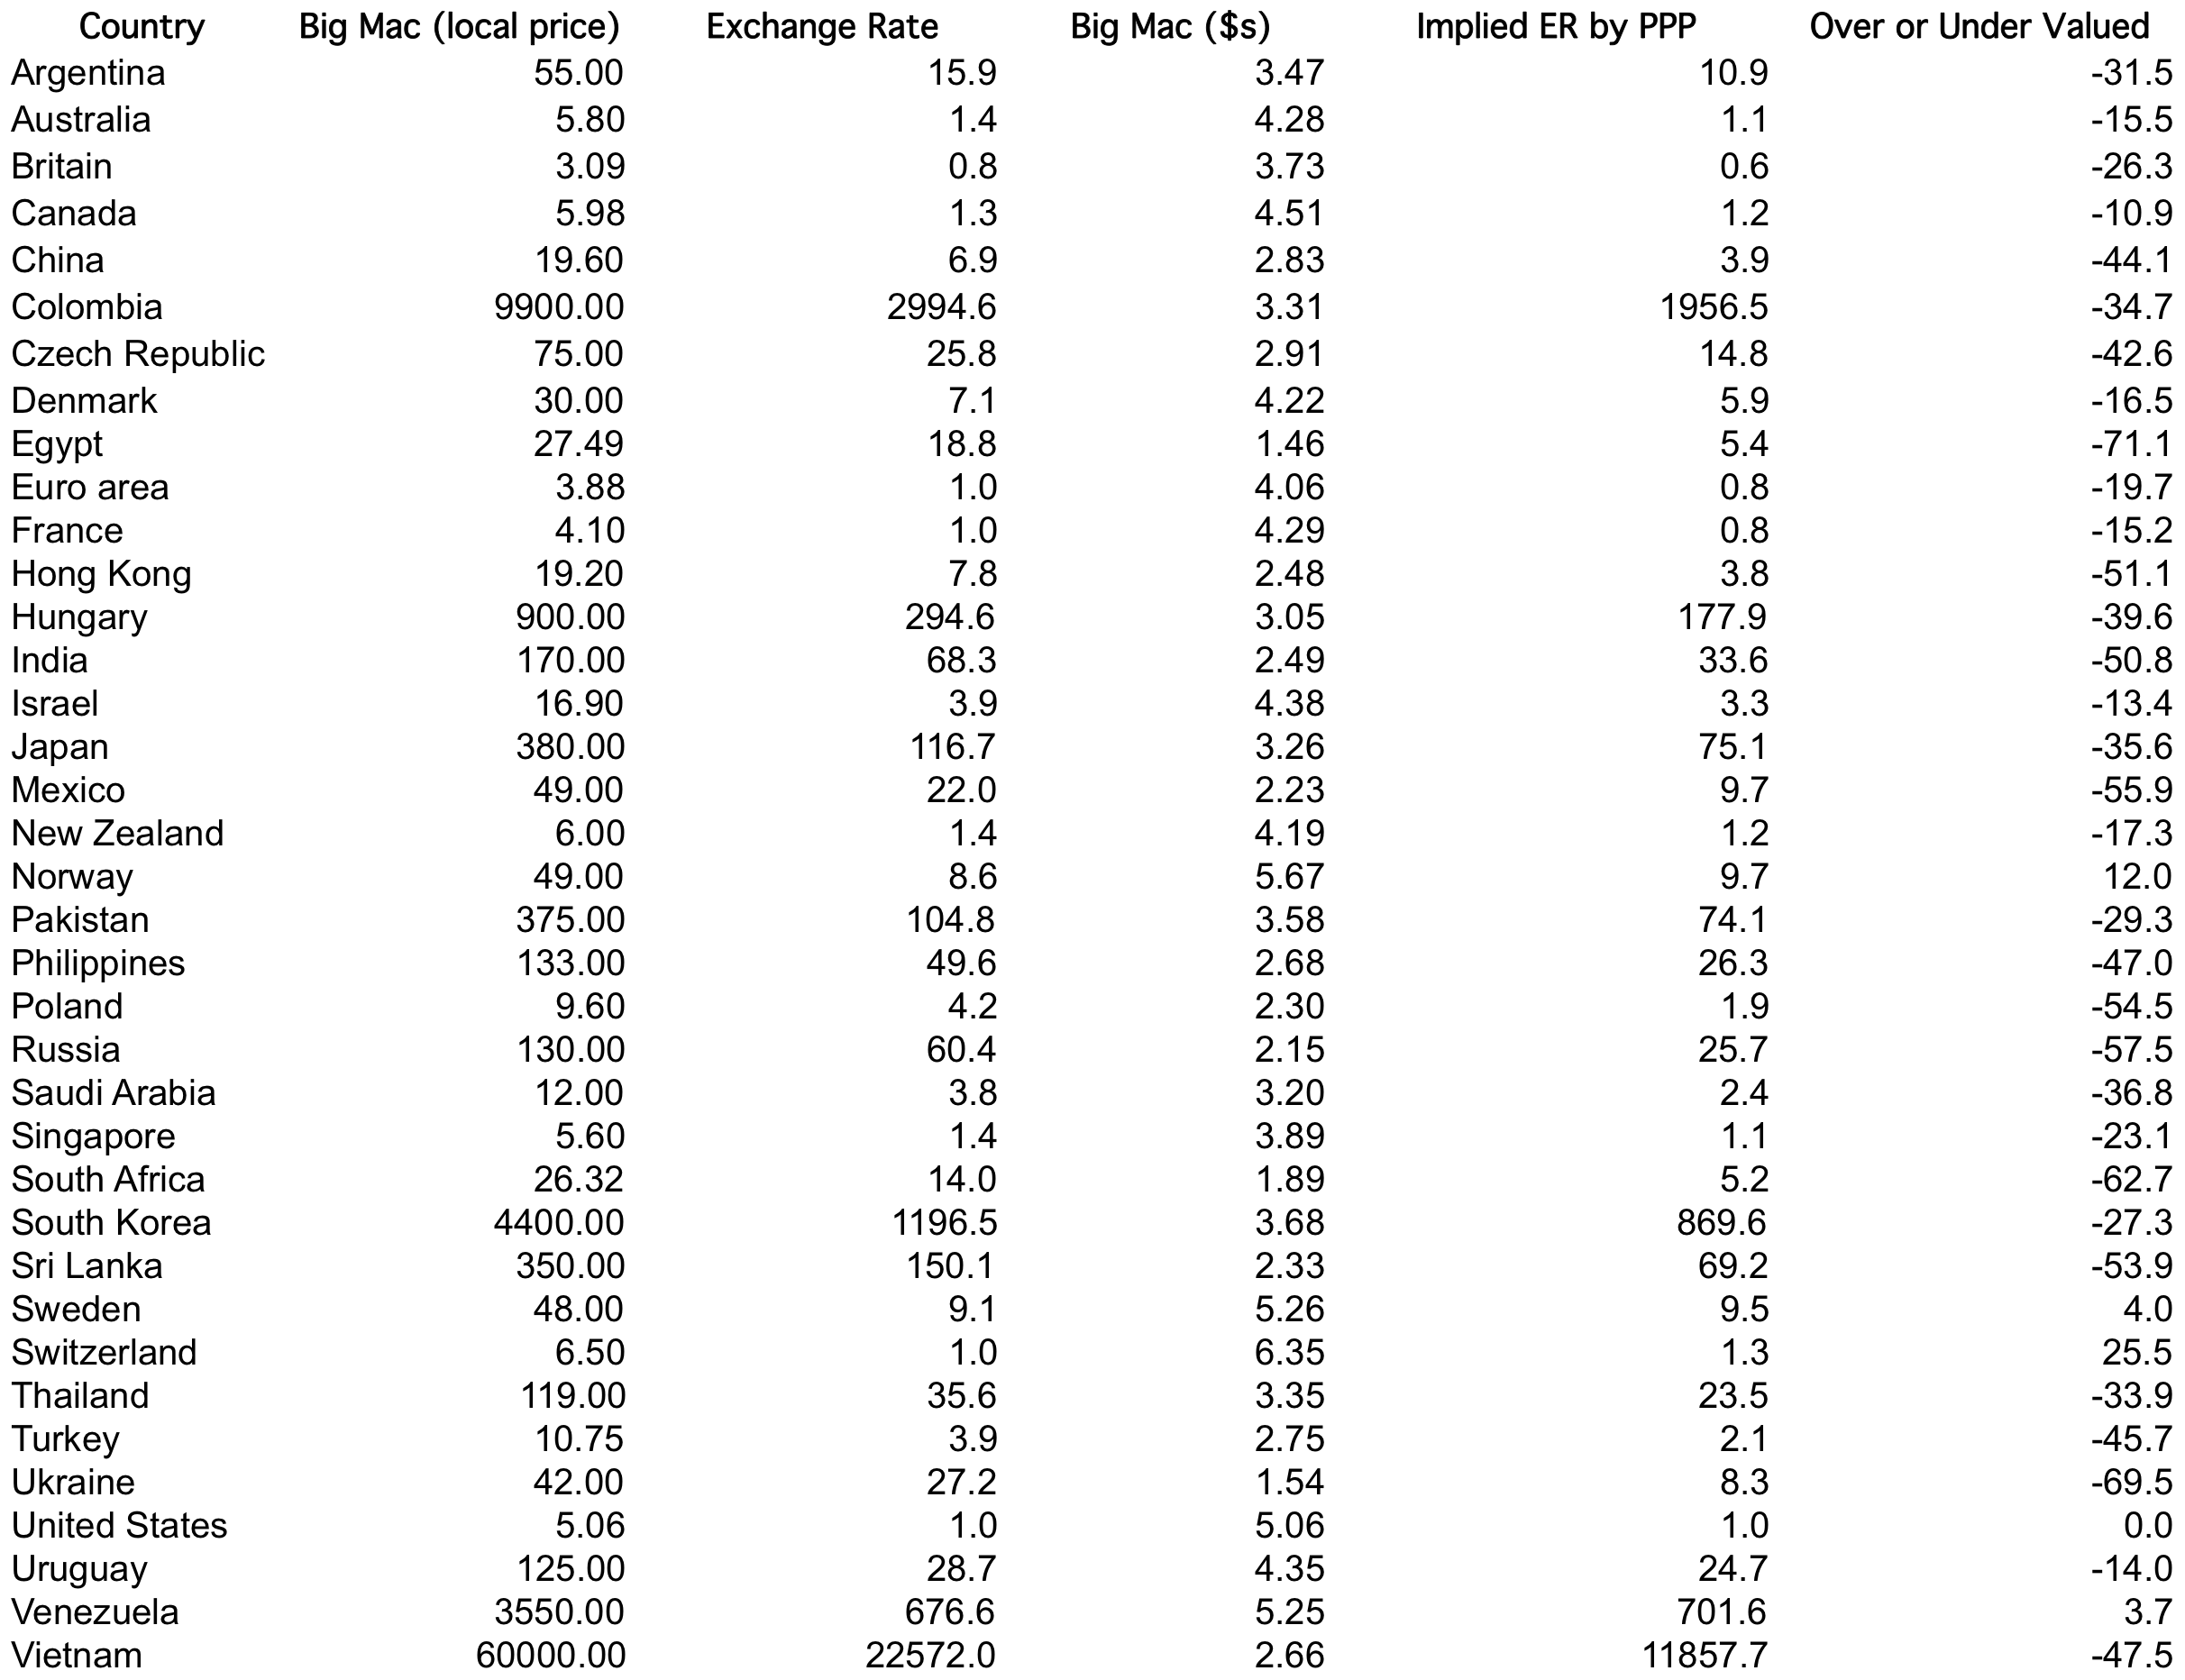
Big Mac Index (January 2017)

Slide 16
Group Work: Big Mac Index (January 2017)
Use the prices of the Big Mac to estimate the real exchange rates for the United States with:
Recall reach exchange is computed as foreign price (in $) / US price ($)
France
Real = 4.29 / 5.06 = 0.848
Nominal = E_{$/Foreign} = 1
Switzerland
Real = 6.35/5.06 = 1.25
Nominal = E_{$/Foreign} = 1
South Africa
Real = 1.89/5.06 = 0.374
Nominal = E_{$/Foreign} = 0.0714
Hungary
Real = 3.05 / 5.06 = 0.603
Nominal = E_{$/Foreign} = 0.0034

